Slide 1
UNO: A COMPREHENSIVE ANALYSIS OF REINFORCEMENT LEARNING BASED AGENT
Gaurav Sharma (2021AIM1008)
Ishan Tripathi (2021AIM1009)

Slide 2
AIM
The card game Uno is a relatively simple to understand yet an overwhelming environment (10¹⁶³ combinations) to explore for a given decision-making agent. The rational agent is expected to perform well and win against its opponent despite the several sources of uncertainty involved throughout the course of the game.
Through our paper we seek to explore in search of tangible observations for the following topics:
Is UNO a game of luck or a game of skill?
How many turns does it take to win a game?
Does the player having the first turn have an edge over its opponent/s?
Performance evaluation of three decision-making agents when competing against each other. The agents are:
Random Agent
Card Counting Agent
Reinforcement Learning Based Agent (Q-Learning and Monte Carlo Techniques)

Slide 3
REFERENCES
‘Towards Learning How to Properly Play UNO with the iCub Robot’ by Pablo Barros, Stefan Wermter, Alessandra Sciutti published in 2019.
‘Reinforcement Learning on Spades’ by T Culhane.
https://github.com/PhilippThoelke/uno-bot
https://github.com/kyler-harrison/uno-rl

Slide 4
MAIN IDEA
CARDS
Most granular element of the game
Has a “color” and “value” property
Evaluated if it is playable or not, depending upon the currently open card.
DECK
A fixed list of UNO cards
Initialized and shuffled at the beginning of each game
Cards drawn from it and can be refilled
PLAYER
Has a name, hand cards, and playable hand cards as properties
Identifies current state (cards he holds etc.)
Recognize the possible actions (cards he can play)
Incorporate decision making logic from the RL-agent
TURN
The active player (whose turn it is) either draws or plays a card
GAME
A series of turns until any of the players wins

Slide 5
CHARACTERISTICS
The game has been framed as a finite Markov Decision Process (MDP), with following characteristics:
States: Each step of the game can be described by a state
Actions: The agent interacts with the game by taking actions based on the state he is in
Rewards: Taking certain actions can lead to a desirable terminal state (e.g. winning the game), which is rewarded
Actions
States | Red | Grn | Blu | Ylw | Skp | Rev | +2 | +4 | Wld
(“Red”,2,0,1,0,0,1,0,1,0,2,0,0,0,0,1,0) | 1 | 0 | 0 | 0 | 0 | 0 | 0 | 0 | 0
(“Green”,2,1,1,0,0,1,0,1,1,2,0,0,0,0,1,0) | 0 | 1 | 0 | 0 | 0 | 0 | 0 | 0 | 0
(“Blue”,2,0,0,0,0,1,0,1,0,2,0,0,0,0,1,0) | 0 | 0 | 1 | 0 | 0 | 0 | 0 | 0 | 0
Rewards

Slide 6
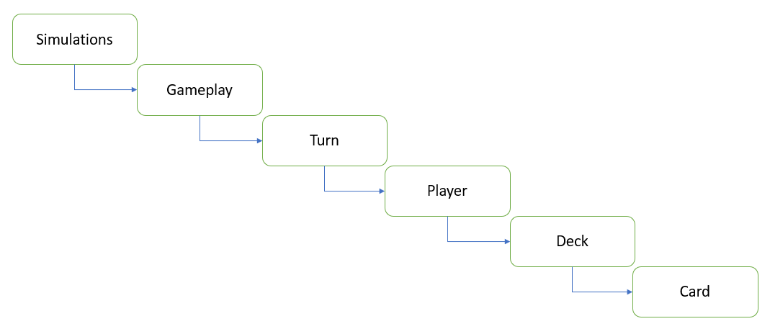
Hierarchy in UNO Game Engine

Slide 7
Our Contribution
In this term project, we dedicated our efforts to:
Understanding the computational complexities involved in the game of UNO
Grasp the intricacies of training a Reinforcement Learning based agent
Successfully create the UNO environment and train agents on the same
Extend the respective previous work to provide tangible answers
Compete RL Based agent with Random and Card counting agent
Compare the Q-Learning approach with Monte Carlo method

Slide 8
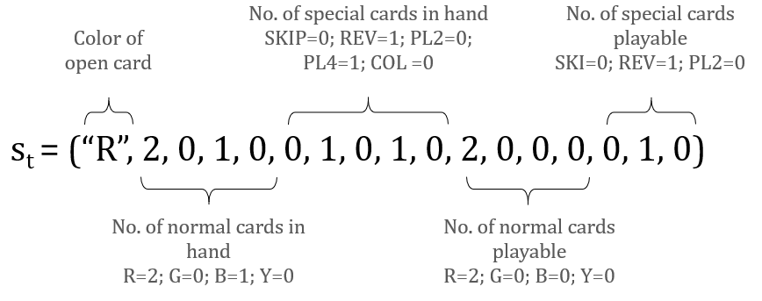
State Breakdown

Slide 9
Monte Carlo Reward Update

Slide 10
Q-Learning Reward Update

Slide 11
RL Based Agent vs Random Agent
The following results were observed by using the following configurations:
RL Algorithm: Q-Learning
Total Simulations: 10,000
Epsilon Threshold: 0.2
Step Size: 0.2
The agent starts learning from scratch

Slide 12
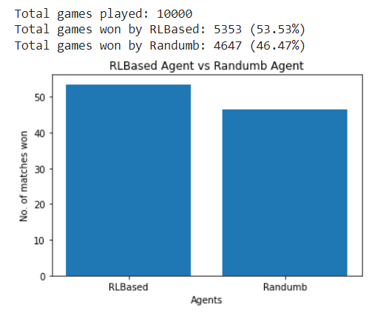
RL Based Agent vs Random Agent
Dominance Analysis

Slide 13
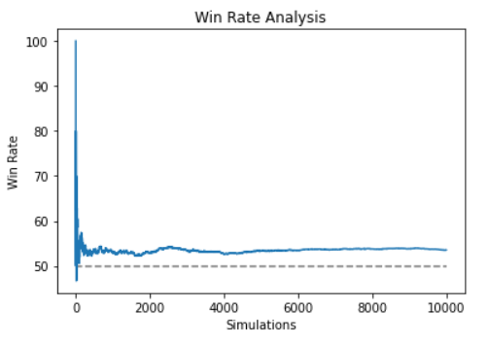
RL Based Agent vs Random Agent
Win Rate Analysis

Slide 14
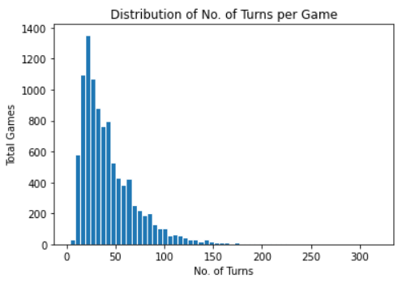
RL Based Agent vs Random Agent
Distribution of No. of Turns per Game

Slide 15
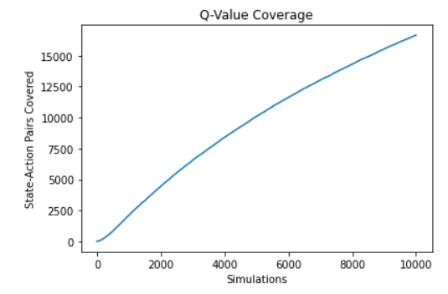
RL Based Agent vs Random Agent
State-Action Pairs Visited

Slide 16
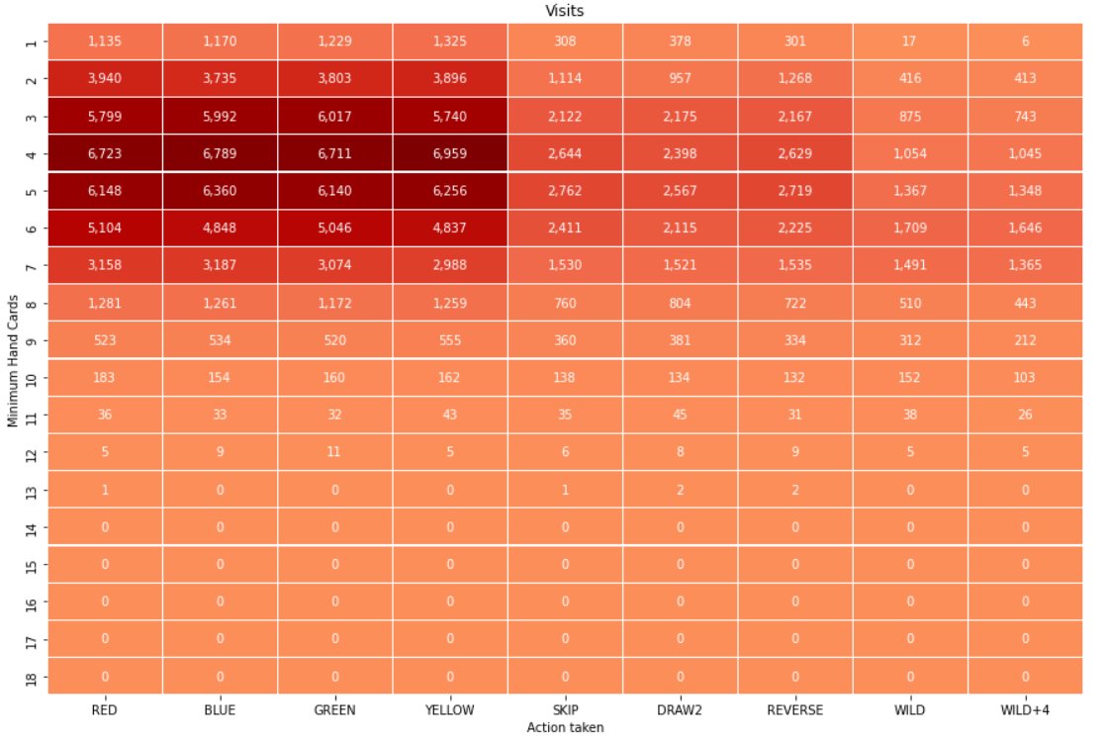
RL Based Agent vs Random Agent
Distribution of Q-values across the Game

Slide 17
Training RL Based Agent Using Monte Carlo
The following results were observed by using the following configurations:
RL Algorithm: Monte Carlo
Total Simulations: 400
Epsilon Threshold: 0.2
Step Size: 0.2
The agent starts learning from scratch

Slide 18
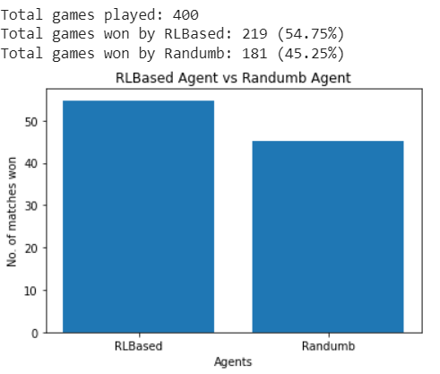
Monte Carlo Results
Dominance Analysis

Slide 19
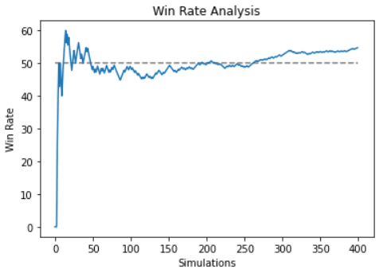
Monte Carlo Results
Win Rate Analysis

Slide 20
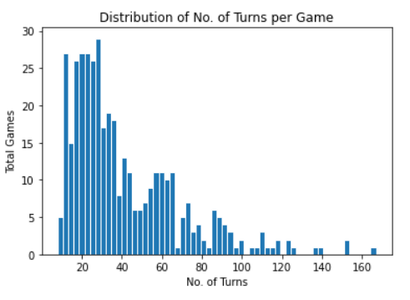
Monte Carlo Results
Distribution of No. of Turns per Game

Slide 21
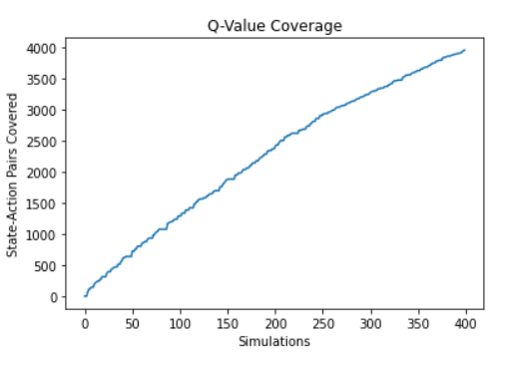
Monte Carlo Results
State-Action Pairs Visited

Slide 22
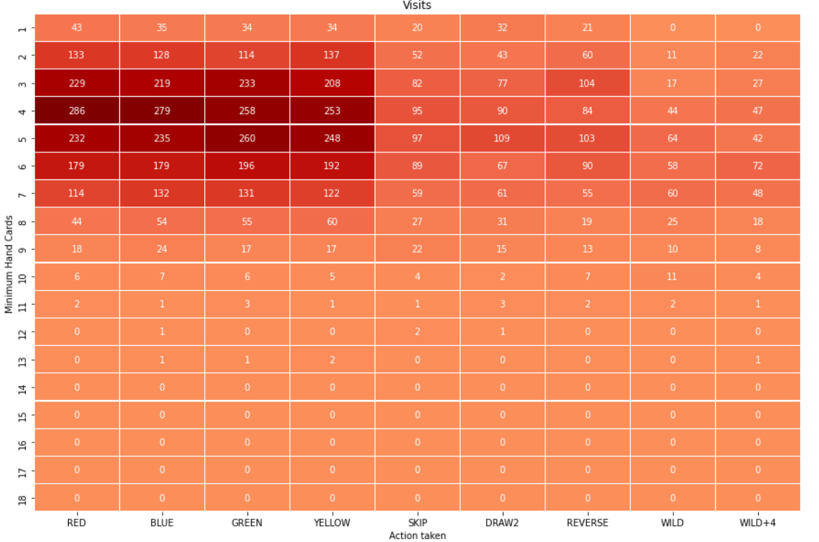
Monte Carlo Results
Distribution of Q-values across the Game

Slide 23
Further Enhancements
Take into account the number of cards in the opponent’s hand when forming a state of the UNO environment
Might consider removing the available cards and only focussing on the playable cards
Impart dynamic behavior to the epsilon threshold
The random behavior should ideally decrease as the training progresses, considering a known static environment as in the case of UNO
Extend the Game engine to support multi-player rounds

Slide 24
Conclusion
At last, UNO turned out to be a ‘Game of Luck’
Generally, a round of UNO lasts for approx. 36 turns
The agent playing first DOES have an advantage over its opponent, however the nature of both the agents must be kept same (Random vs Random, etc.)
It was observed that as the agent gained better knowledge of the environment, not only was it able to dominate its opponents but also it was able to win games much quicker, i.e., in less turns

Slide 25
Thank You!

